Slide 1
Mini-Project
TY EXTC Semester VI ( 2023-24)
16010321032 Aditya Pandey
16010321033 Atharva Dalvi
16010321034 Janvi Panwar
16010321035 Jay Patil

Slide 2
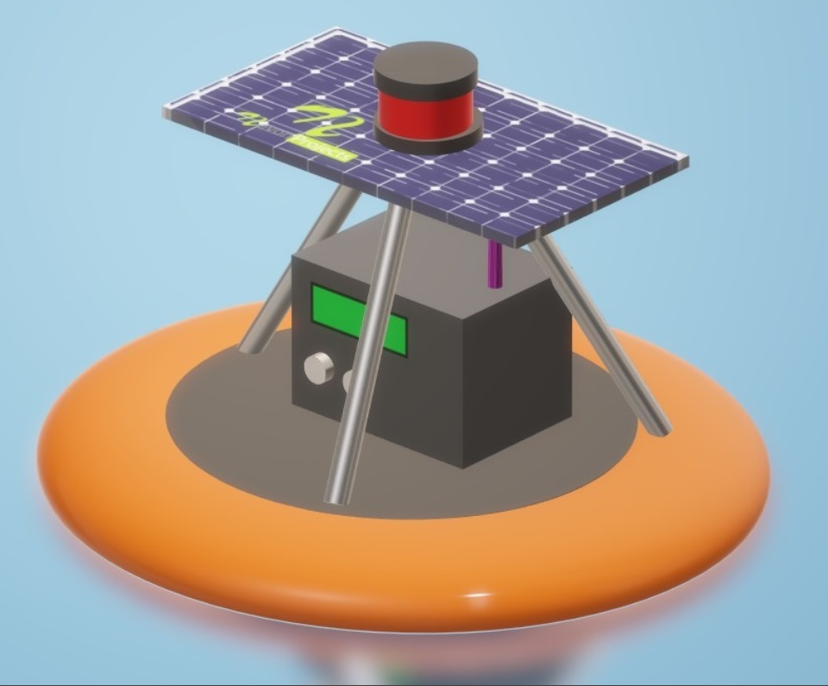
Topic -
Water Quality
Monitoring
Buoy

Slide 3
Content
S. No. | TOPIC
1 | Introduction
2 | Need Statement
3 | Literature Review
4 | Problem Statement
5 | Scope of Project
 | Hardware / Software requirement
6 | Block Diagram
7 | Algorithm
8 | Analysis

Slide 4
Introduction
What is water pollution?
The World Health Organization (WHO) says that polluted water is water whose composition has been changed to the extent that it is unusable.
The main water pollutants include bacteria, viruses, fertilizers, pesticides, oil, pharmaceutical products, various chemicals, plastics, and even some radioactive substances.
These substances do not always change the color of the water, meaning that they are often invisible pollutants.
Therefore, to detect them we can use extra measures like turbidity and ph level, temperature of water, where turbidity is the measure of relative clarity of a liquid and ph is the degree of alkalinity or acidity of water.

Slide 5
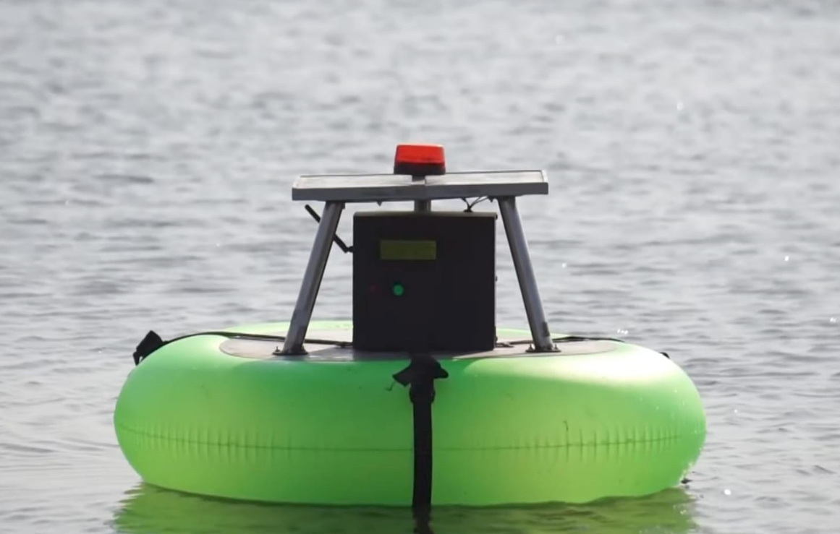
Need Statement
Traditional stationary monitoring methods are often limited by high operational costs and the necessity for manual data collection. Our project aims to leverage advanced sensor technology for the same.
This technology is essential for providing consistent, accurate, and comprehensive data on water turbidity, temperature, pH levels, and sea weather conditions.
The implementation of this buoy is crucial for enhancing our understanding and response to the growing challenges of marine pollution and climate-related changes in marine ecosystems.
It will enable more effective environmental monitoring and management, contributing significantly to the preservation and protection of our oceans.

Slide 6
LITERATURE REVIEW
S. No. | Title | Methodology | Limitations | Components used | Remarks
1 | A Low-Cost AI Buoy System for Monitoring Water Quality at Offshore Aquaculture Cages Publication Year -27.05.2022 Citation – [1] | AI WCN ML water quality Zigbee | Limited to Aquaculture cages Expensive (overall cost 2015 US Dollars) | LoRa module GPS module Solar controller | Our project is – More affordable Uses open source software
2 | IoT Based Water Pollution Monitoring RC Boat Publication Year –May 2022 Citation – [2] | Remote Controlled boat Data Logging as well as IOT Online Transmission | Limited operating time Low range operation Safety issues | Rudder Propeller NRF transreceiver Sensors. Motor, Servo Motor | Our project is – Buoy and not boat Solar powered self charging batteries Thingspeak cloud server-data visualization
3 | Renewable Powered Portable Weather Update Station Publication Year – 2019 Citation – [3] | Meteorological Parameters GSM for data transmission Self charging | Only measures atmospheric data High Power Consumption Only used for ground operations. | Arduino Mega LCD, GSM Module Sensors – Barometer, gas detector, termperature, humidity Solar Panel | Our project is – Buoy Sea weather Monitoring Power efficient

Slide 7
LITERATURE REVIEW
S. No. | Title | Methodology | Limitations | Components used | Remarks
4 | A GSM Based Water Quality Monitoring System using Arduino Publication Year - 02.04.2019 Citation – [4] | Automated system using IoT for enhanced monitoring Emphasizes on power-efficient system | No Self Charging No cloud service for data visualization | Sensors – pH, Conductivity, Temperature Arduino Uno Board GSM Module | Our project uses - Solar powered self charging batteries Thingspeak cloud server-data visualization
5 | Arduino Based Solar Powered Battery Charging System For Rural SHS Publication Year –17.11.2016 Citation – [5] | MPPT Wi-Fi module for remote surveillance | It is just a solar powered charging system | Battery Solar cells WiFi Module | Not a buoy
6 | Iot Based Water Quality Monitoring System Publication Year –April 2016 Citation – [6] | Zigbee protocol IOT Cloud Computing | Zigbee req high strength WiFi network Expensive | Raspberry pie Conductivity sensor Dissolved oxygen sensor | Our project uses - Solar powered self charging batteries ESP 32 is affordable
7 | Real time, low power, high data rate and cost effective transmission scheme for coastal buoy system Publication Year –Oct 2013 Citation – [7] | GPRS GPS FTP | Expensive materials and system Large size Heavy weight | fiber reinforced plastics filled with polyurethane Sensors – humidity, Anemometer, conductivity and temp. | Our project uses - Solar powered self charging batteries Thingspeak cloud server to store data

Slide 8
LITERATURE REVIEW:
S. No. | Title | Methodology | Limitations | Components used | Remarks
8 | IoT based smart water quality monitoring system Publication Year -02.07.2021 Citation – [8] | Wifi Module IOT Sensor Integration | Limited operating time Low range operation Use of extra components | Sensor – pH, turbidity, termperature, humidity, conductivity, CO2 Arduino ATMEGA ESP 8266, LCD | Our project is – Solar powered self charging batteries Accelerometer used for high tide detection Long range operation
9 | Smart water quality monitoring system with cost-effective using IoT Publication Year – 26.05.2020 Citation – [9] | Wifi Module IOT Sensor Integration | Limited operating time Low range operation Use of extra components | Sensor – pH, turbidity, termperature, humidity, conductivity, CO2, Ultrasonic Arduino ATMEGA Wifi module | Our project is – Solar powered self charging batteries Accelerometer used for high tide detection Long range operation
10 | IoT Based Underwater Robot for Water Quality Monitoring Publication Year – 2020 Citation – [10] | Under water Operations Recon purpose Wifi camera | Limited operating time Low range operation High power consumption | Arduino UNO Esp32 CAM Stepper, gear motor Water pump Sensor – pH, turbidity, temperature | Our project is – Buoy Power efficient Solar powered self charging batteries Accelerometer used for high tide detection Long range operation

Slide 9
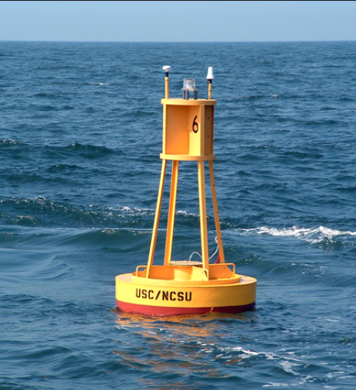
Problem Statement
List objectives
Water Quality Assessment
Senor Integration
Data Transmission and Analysis
Problem Statement –
The increasing pollution in marine environments and the need for continuous monitoring of water quality and sea weather conditions present significant challenges. Traditional methods of monitoring are often limited by their stationary nature, high operational costs, and the need for manual data collection. To address these issues, the development of a Water Quality Monitoring Buoy is proposed. This buoy aims to autonomously assess water quality and sea weather conditions using advanced sensors. By providing real-time, continuous data, it will enhance our ability to monitor and respond to environmental changes in marine ecosystems.

Slide 10
Scope of Project
Water Quality Monitoring
Sensor integration
Data collection and transmission
Design and construction
Data analysis and reporting
Project management

Slide 11
Hardware / Software Requirements
ESP Wroom 32
pH sensor
Turbidity sensor
DHT 11 temperature sensor
ThingSpeak software

Slide 12
Hardware Equipment Cost
S. No. | Component | Features | Approximate Cost | Comparison | Remarks
1 | Esp 32 (WROOM 32) Microcontroller | 18 ADC channels 3 UART Interfaces built-in Wifi module Low power consumption | ₹ 400 | Arduino No built-in Wifi module Less processing power and memory | Esp Consumes less power Can easily interface/integrate all sensors
2 | pH Level Sensor Kit | Response time<= 5 s Stability time <= 120s Low power consumption | ₹ 2000 | LABART NPK,PH Lesser pH range More power supply required | Better Accuracy Cost effective Lower power consumption
3 | Turbidity Sensor | Response time < 500ms Operating temperature: -32 to 80°C Current: 30mA | ₹ 600 | Changes according to the amount TSS | Cost effective Compatibility Low power consumption Measuring range of 0 to 1000 NTU
4 | DHT 11 | Temperature Range :0 to 50°C Humidity Range: 20% to 90% rh | ₹ 72 | BME 280 Complex Expensive | Low power consumption Cost effective Does not need configuration

Slide 13
Ph Sensor calibration
pH (7) = 2.5 V
pH (4) = 3V
Thus, voltage = sensor value x (3.3/4095.0)
Slope = ΔpH / ΔVoltage
Intercept = 7 – ( slope x voltage )
pH = (voltage x slope) + intercept …………………… ( y = mx+c)

Slide 14
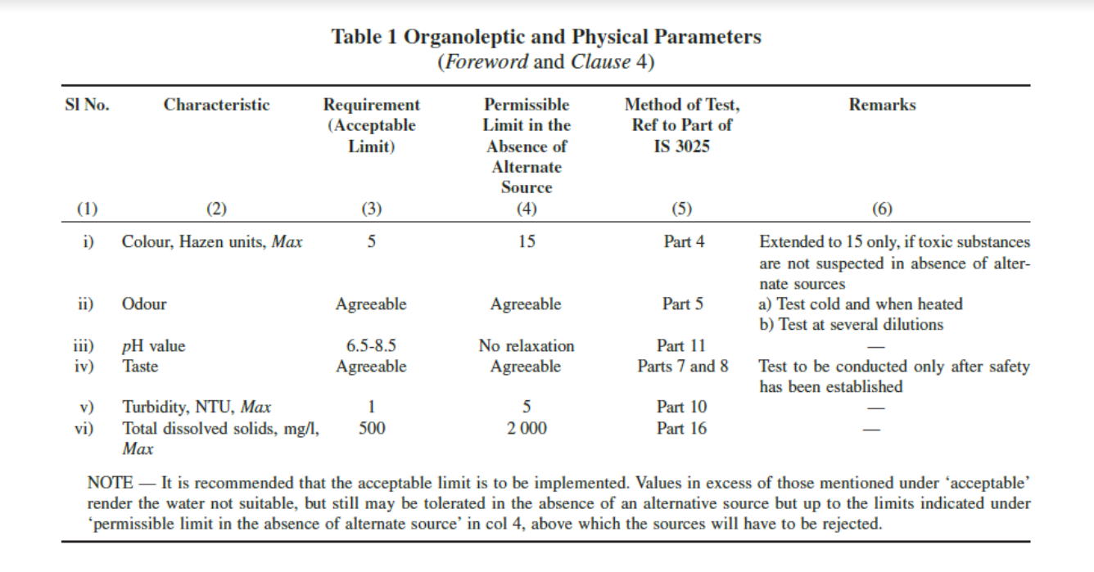
Standard Values (Acc. To BIS)

Slide 15
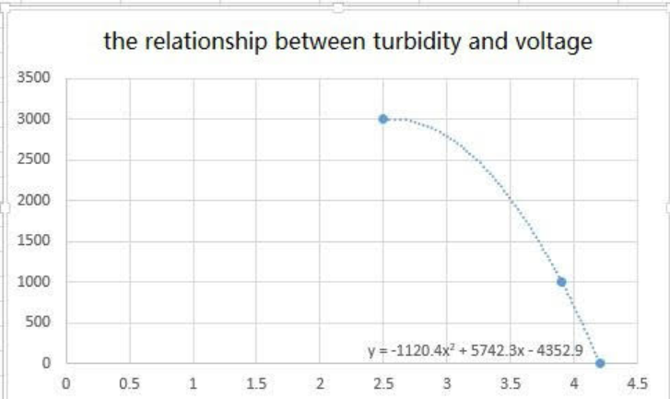
Turbidity Sensor calibration

Slide 16
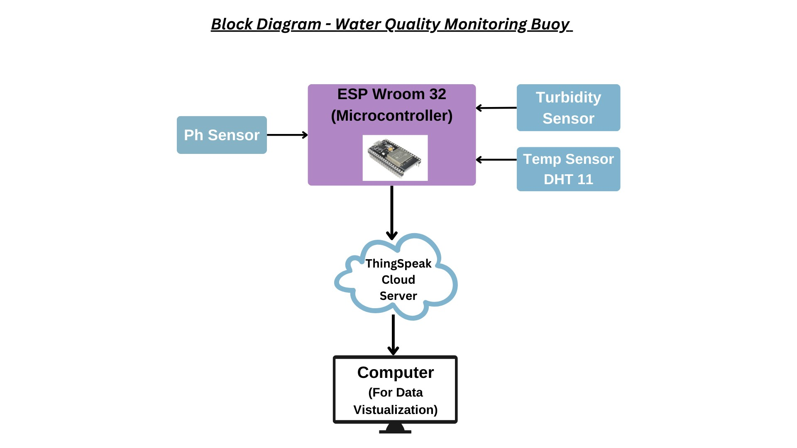
Block Diagram

Slide 17
Algorithm of the Code
Setup –
Initialize serial communication.
Connect to WiFi.
Initialize sensors.
Main Loop:
Check WiFi connection.
If connected:
Read from DHT sensor (temperature and humidity).
Read pH value.
Read turbidity value.
Send data to a server using HTTP POST.
If not connected, indicate a WiFi disconnection.
Reading pH:
Read analog value from pH sensor.
Convert to voltage.
Calculate pH using calibration data.
Reading Turbidity:
Read analog value from turbidity sensor.
Convert to voltage.
Map analog value to NTU (Nephelometric Turbidity Units).

Slide 18
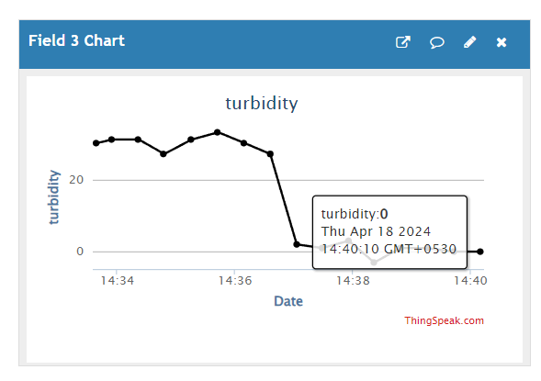
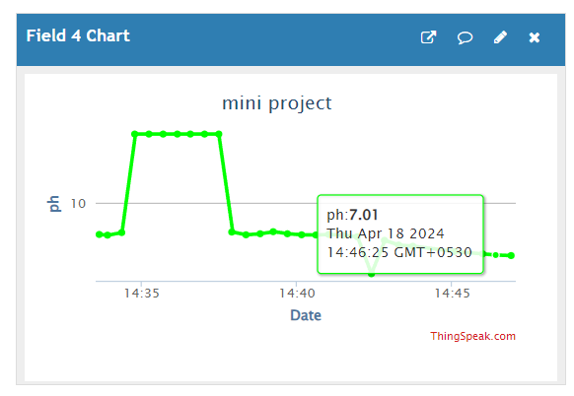
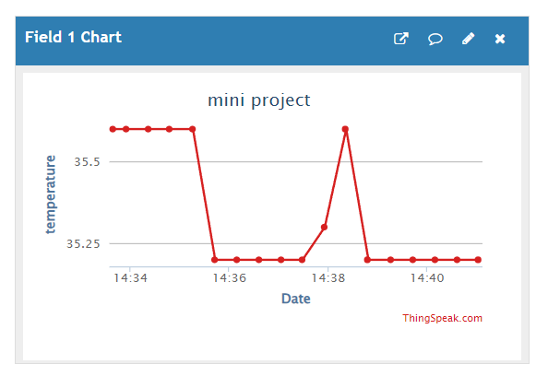
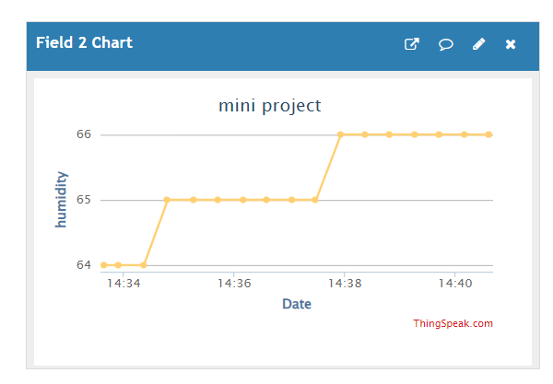
Water

Slide 19
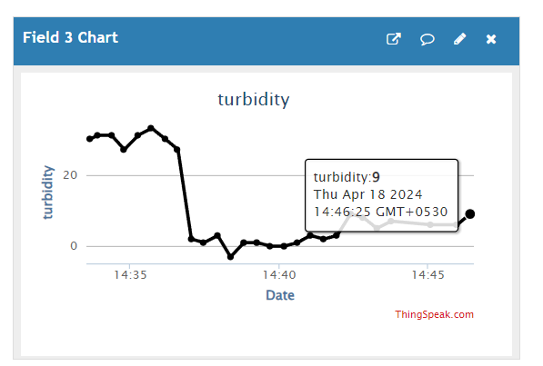
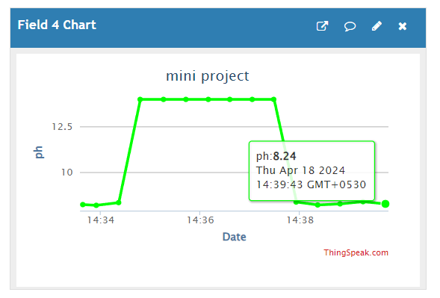
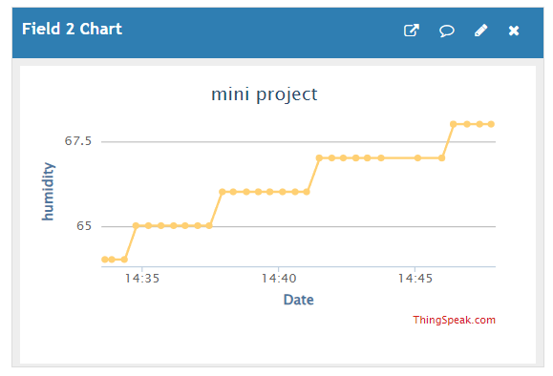
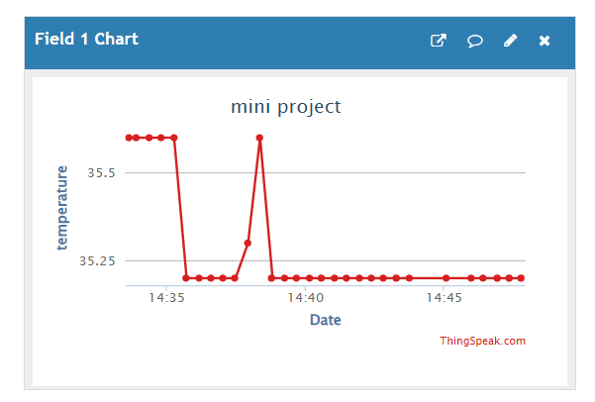
Lake Water

Slide 20
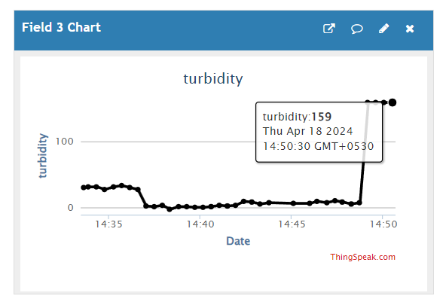
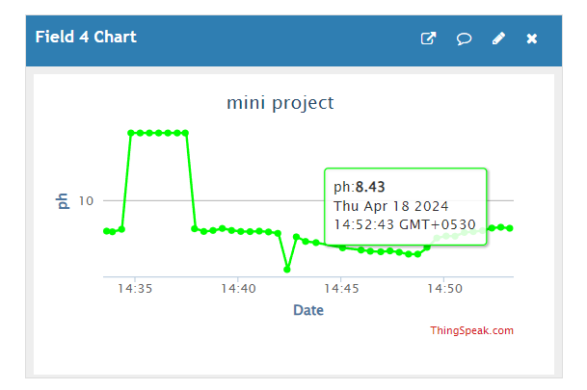
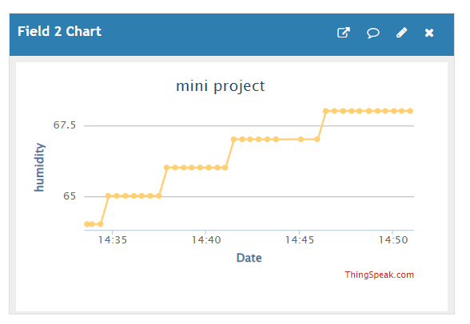
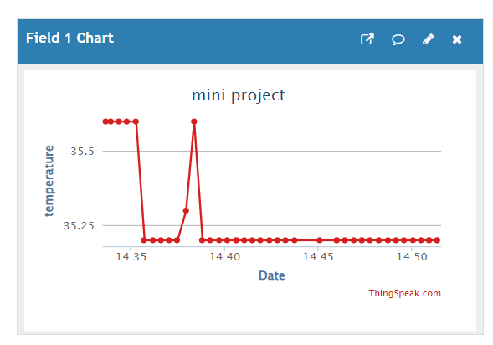
Polluted Water

Slide 21
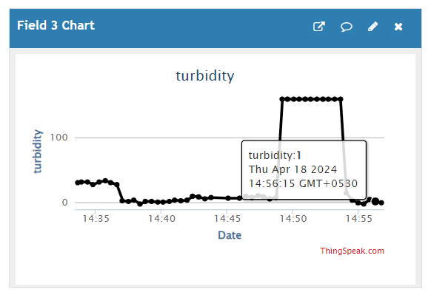
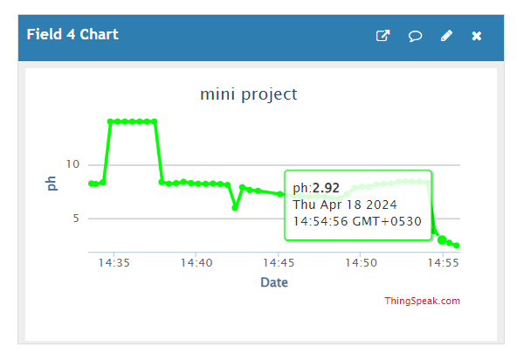
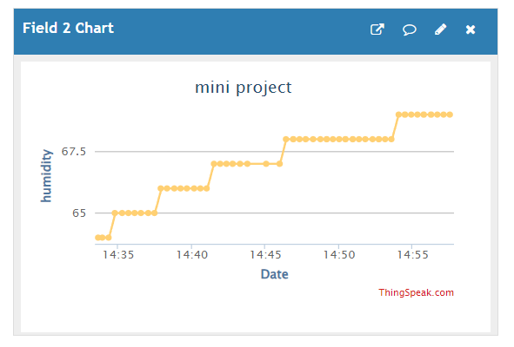
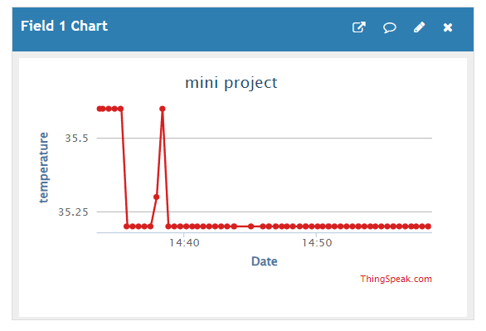
Carbonated Water

Slide 22
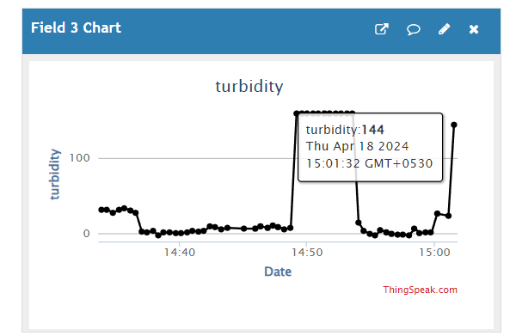
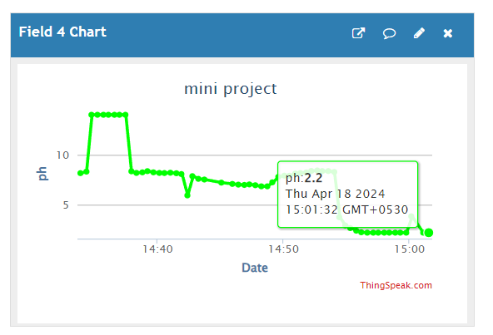
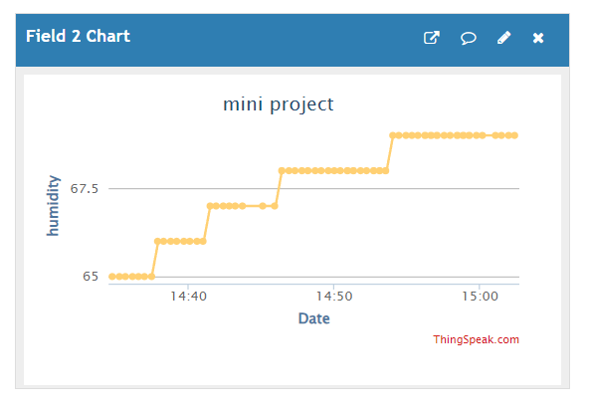
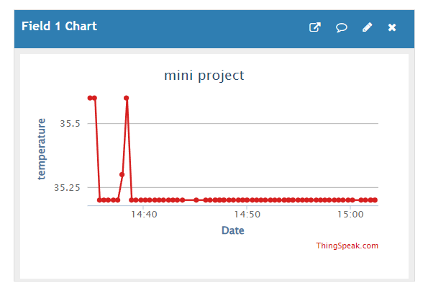
Pepsi Soft drink

Slide 23
Analysis
Sample | pH level | Turbidity (ntu) | Temperature(°C) | Humidity
Clear Water | 7.01 | 0 | 35 | 66%
Lake Water | 8.24 | 9 | 35 | 68%
Polluted Water | 8.43 | 159 | 35 | 68%
Carbonated water | 2.92 | 1 | 35 | 69%
pH:
The ideal pH level for most aquatic organisms is between 6.5 and 8.5 like in the case of lake/polluted water.
The Carbonated Water (pH 2.92) is highly acidic, which can harm fish gills and disrupt other bodily functions.
Significant deviations in pH can disrupt metabolism, growth, and reproduction.
Ammonia is a common waste product in aquatic environments. At high pH levels, the less toxic ammonium form (NH4+) converts to the highly toxic free ammonia (NH3). This can be particularly harmful to fish and invertebrates with sensitive gills.

Slide 24
Analysis
Turbidity:
High turbidity restricts the amount of sunlight reaching deeper water layers. This disrupts photosynthesis for aquatic plants, which form the base of the food chain in many aquatic ecosystems.
Turbid water can alter the behavior of some aquatic life by reducing visibility. This can make it more difficult for fish to find food and mates, and may increase predation risk
Organic matter, such as decaying leaves, may have less detrimental effects than inorganic pollutants like heavy metals.
The "polluted water" sample with 159 NTU turbidity likely has a significant negative impact on the ecosystem.
Humidity:
Varies slightly from 66% to 69%. While humidity does not directly affect the water quality, it can influence the rate of evaporation and thus the concentration of substances in the water.

Slide 25
Analysis
Temperature:
Water temperature influences the metabolic rate of aquatic organisms. Warmer water generally leads to increased activity and oxygen consumption.
Colder water can hold more dissolved oxygen than warmer water. If the water temperature rises significantly, the amount of dissolved oxygen may become insufficient to support aquatic life. *
Different aquatic species have preferred temperature ranges. Significant and rapid temperature changes can disrupt the balance of an ecosystem by favoring certain species over others.
The impact of temperature depends on the specific water body and the organisms present. Freshwater fish generally have a narrower temperature tolerance than marine fish. The reading of 35°C, while within the range for some freshwater fish, is on the higher end and could be stressful for some species.
The combined effects of these factors can be more significant than the individual effects. For example, high temperature can exacerbate the negative effects of low pH or high turbidity.

Slide 26
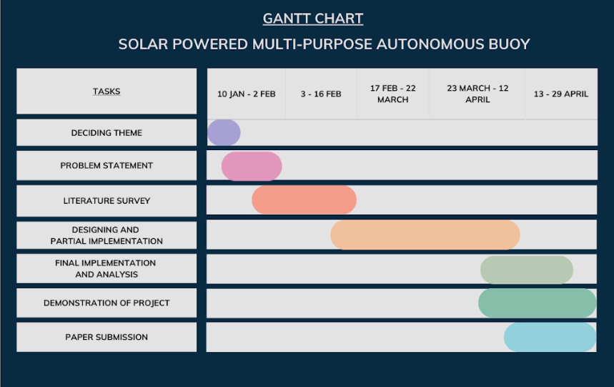
Time line Chart

Slide 27
CITATIONS
Lu, H.-Y.; Cheng, C.-Y.; Cheng, S.-C.; Cheng, Y.-H.; Lo, W.-C.; Jiang, W.-L.; Nan, F.-H.; Chang, S.-H.; Ubina, N.-A. A Low-Cost AI Buoy System for Monitoring Water Quality at Offshore Aquaculture Cages. Sensors 2022, 22, 4078. https:// doi.org/10.3390/s22114078
HAQUE, S. I., SIDDIKY, M. M., RAHMAN, M. A., SHAIKAT, M. H., & HASAN, R. R. (2023). IOT based Water Pollution Monitoring Multifunctional Boat using Solar panel with Dual Axis Tracker (Doctoral dissertation, Faculty of Engineering, American International University–Bangladesh).
Haque, M. I., Shatil, A. H. M., Tusar, A. N., Hossain, M., & Rahman, M. H. (2019, January). Renewable powered portable weather update station. In 2019 International Conference on Robotics, Electrical and Signal Processing Techniques (ICREST) (pp. 374-377). IEEE.
Gokulanathan, S., et al. “A GSM Based Water Quality Monitoring System Using Arduino.” Shanlax International Journal of Arts, Science and Humanities, vol. 6, no. 4, 2019, pp. 22–26.
T. Kaur, J. Gambhir and S. Kumar, "Arduino based solar powered battery charging system for rural SHS," 2016 7th India International Conference on Power Electronics (IICPE), Patiala, India, 2016, pp. 1-5, doi: 10.1109/IICPE.2016.8079373.

Slide 28
CITATIONS
International Journal of Industrial Electronics and Electrical Engineering, ISSN: 2347-6982 Volume-4, Issue-4, Apr.-2016
Vengatesan, G., Muthiah, M. A., Upadhyay, J. S., Sundaravadivelu, N., Sundar, R., & Venkatesan, R. (2013, October). Real time, low power, high data rate and cost effective transmission scheme for coastal buoy system. In 2013 Ocean Electronics (SYMPOL) (pp. 1-6). IEEE.
8. Lakshmikantha, V., Hiriyannagowda, A., Manjunath, A., Patted, A., Basavaiah, J., & Anthony, A. A. (2021). IoT based smart water quality monitoring system. Global Transitions Proceedings, 2(2), 181-186.
9. Pasika, S., & Gandla, S. T. (2020). Smart water quality monitoring system with cost-effective using IoT. Heliyon, 6(7).
10. Gupta, S., Kohli, M., Kumar, R., & Bandral, S. (2021). IoT based underwater robot for water quality monitoring. In IOP Conference Series: Materials Science and Engineering (Vol. 1033, No. 1, p. 012013). IOP Publishing.

